Slide 1
Waste Water Management
EVS Activity 4
Team Members:
Ankit Meena, Shubham, Sachin Rajbhar, Nitish Tiwari, Harsh Kumar, Ashish K. Pathak

Slide 2
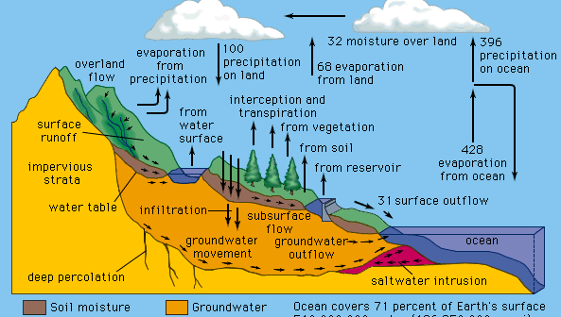
Water
water, a substance composed of the chemical elements hydrogen and oxygen and existing in gaseous, liquid, and solid states.
Water also exists on other planets and moons both within and beyond the solar system.

Slide 3
Waste water management
Wastewater is any water that requires cleaning after it is used. This includes water that has been used for laundry, bathing, dishwashing, toilets, garbage disposals, and industrial purposes.
The goal of wastewater management is to clean and protect water for drinking and washing, and by industry for commercial purposes

Slide 4
Wastewater is usually divided into two major groups:
point source wastewater : Point source wastewater includes wastewaters that enter natural waters (such as lakes, rivers, and oceans) from defined locations. The most common point sources are sanitary sewers and storm drains.
Non-point source wastewater: It is wastewater that is not connected to a specific source. This includes runoff (water that drains away) from agriculture and urban (city) areas, and acidic waters from mines.

Slide 5
Purpose | Water Usage (in litres) | Waste Water (in litres) | Measures to save water
Cooking | 4 | 2 | Put into Plants, garden
Cloth Washing | 20 | 12 | Reuse the used water to clean all clothes
Car Washing | 30 | 15 | Use wet cloth for cleaning vehicles
Bathing | 9 | 5 | Use shower for easy water spread on body
Brushing | 4 | 2 | Use water from mug

Slide 6
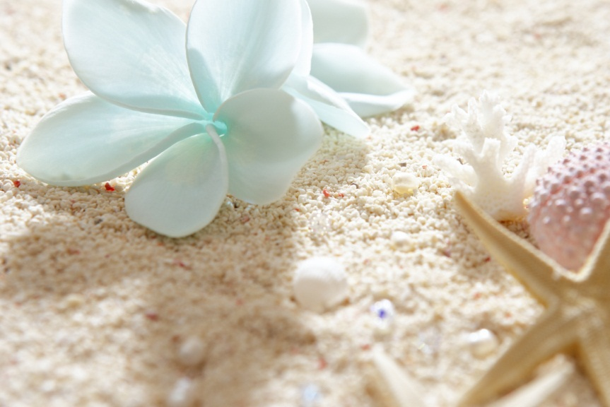
Thank you
Cheers! Save Water Save Life

